Slide 1
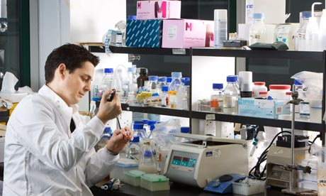
Trans-NCI-NIH Conference on International Perspectives on Integrative Medicine for Cancer Prevention and Cancer Patient Management
Conference Aims: 1) Discuss the integration of traditional, complementary and alternative medicine (TCAM) with conventional cancer prevention and treatment approaches for low-and-middle-income-countries (LMICs) and 2) Discuss approaches for strengthening Integrative Oncology research in LMICs.
When & Where: May 20-21, 2020, Natcher Building, NIH Main Campus, Bethesda, Maryland
For more formation please contact: Dr. Alejandro Salicrup salicrul@mail.nih.gov; https://cam.cancer.gov

