Slide 1
N-of-1 trials:
building rigorous evidence
with each patient seen
Sunita Vohra MD MSc FRCPC FCAHS
Professor
Department of Pediatrics and Psychiatry
Faculty of Medicine & Dentistry
University of Alberta

Slide 2
Overview
What are N-of-1 trials and how can they be used?
Trial design, analysis, reporting
Experience with N-of-1 trials
N-of-1 clinic
N-of-1 research
Ethics of N-of-1 trials: are they research vs. enhanced clinical care?

Slide 3
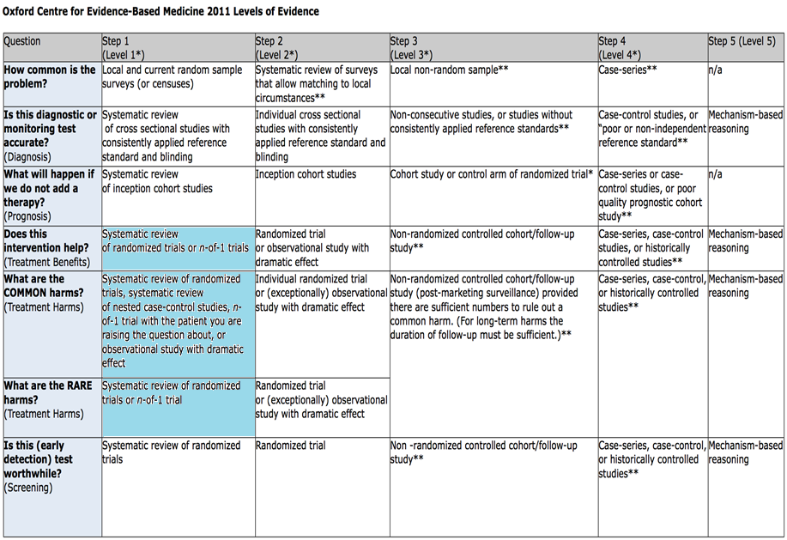
OCEBM Levels of Evidence Working Group. The Oxford 2011 Levels of Evidence. Oxford Centre for Evidence-Based Medicine. http://www.cebm.net/index.aspx?o=5653

Slide 4
How can N-of-1 trials be used?
Paediatrics and/or rare diseases
Large RCTs challenging; difficult to reach adequate sample size
Co-morbid conditions and concurrent therapies
RCTs often exclude these populations
Chronic diseases
To re-evaluate long-term therapy
Patient safety
Reduce polypharmacy
Complementary therapies
Individualized therapies not amenable to RCT; lack to evidence to support RCT
Many more…
Punja et al. J Clin Epidemiol. 2016
Notes:
Punja S, Bukutu C, Shamseer L, et al. The design, analysis and meta-analysis of N-of-1 trials: A tapestry of heterogeneity. J Clin Epidemiol. 2016; 76:47-56.

Slide 5
Most frequent clinical conditions investigated using N-of-1 trials
ICD category | % of included trials (n=100)
Diseases of the nervous system | 27
Diseases of the musculoskeletal system and connective tissue | 20
Mental and behavioural disorders | 17
Diseases of the digestive system | 11
Diseases of the respiratory system | 9
Diseases of the circulatory system | 4
Endocrine, nutritional, metabolic diseases | 2
Infections and parasitic diseases | 2
Other | 8
Adapted from Punja et al. J Clin Epidemiol. 2016
Notes:
Punja S, Bukutu C, Shamseer L, et al. The design, analysis and meta-analysis of N-of-1 trials: A tapestry of heterogeneity. J Clin Epidemiol. 2016; 76:47-56.

Slide 6
Overview
What are N-of-1 trials and how can they be used?
Trial design, analysis, reporting
Experience with N-of-1 trials
N-of-1 clinic
N-of-1 research
Reporting guidelines
Ethics of N-of-1 trials: are they research vs. enhanced clinical care?

Slide 7
N-of-1 trials: design, analysis, reporting
Treatment periods
Treatment pairs
Randomization and blinding
Outcome assessment
Stopping and early stopping
Analysis and meta-analysis
Reporting

Slide 8
Period vs. Pair
Period
A | B | B | A | A | B
Pair

Slide 9
Randomization and Blinding
Order of periods is randomly determined
Study pharmacist maintains randomization code
Patient and health care providers are blinded
N-of-1 trials commonly report being blinded and randomized
Characteristic | N | %
Randomization used | 71 | 71
Described as blinded | 77 | 77
Punja et al. .J Clin Epidemiol. 2016;76: 47-56.
Notes:
Punja S, Bukutu C, Shamseer L, et al. The design, analysis and meta-analysis of N-of-1 trials: A tapestry of heterogeneity. J Clin Epidemiol. 2016; 76:47-56.

Slide 10
Outcome assessment
MYMOP2 (Measure Yourself Medical Outcome Profile)
Patient Generated - outcomes important to patient
Problem specific
7 point scale
Paterson C. Measuring outcomes in primary care: a patient generated measure, MYMOP, compared with the SF-36 health survey.BMJ1996;312: 1016–20

Slide 11
Data Analysis
Different approaches have been identified:
*Number adds up to >100% because some reports used both methods to assess treatment effect
Tests of statistical significance
Paired T-tests – Parametric data
Randomization tests – Non parametric data
Analytic approach | N | %
Statistical analysis | 75 | 75
Visual analysis | 14 | 14
Not reported | 18 | 18
(Punja, 2016)

Slide 12
Meta-analysis
Of identified studies reporting N-of-1 trials, 60% were of >1 participant and 37% pooled individual data
Three common approaches:
Conventional between-group analysis
e.g. Treat series of N-of-1’s as a single crossover trial
Hierarchical Bayesian models
Effect size methods
e.g. Percentage of non-overlapping data
Punja et al. .J Clin Epidemiol. 2016;76: 47-56.
Notes:
Punja S, Bukutu C, Shamseer L, et al. The design, analysis and meta-analysis of N-of-1 trials: A tapestry of heterogeneity. J Clin Epidemiol. 2016; 76:47-56.

Slide 13
N-of-1 trials: design, analysis, reporting
Treatment pairs
Treatment periods
Randomization and blinding
Outcome assessment
Stopping and early stopping
Analysis and meta-analysis
Reporting

Slide 14
CONSORT Statement
A minimum set of recommendations for reporting RCTs
Offers a standard way for authors to prepare reports of trial findings, facilitating their complete and transparent reporting, and aiding their critical appraisal and interpretation
Moher et al. BMJ 2010;340:c869.
Notes:
Moher D, Hopewell S, Schulz KF, Montori V, Gøtzsche PC, Devereaux PJ, Elbourne D, Egger M, Altman DG, for the CONSORT Group. CONSORT 2010 Explanation and Elaboration: updated guidelines for reporting parallel group randomised trial. BMJ 2010;340:c869

Slide 15
Reporting N-of-1 trials: CENT
CONSORT Extension for N-of-1 Trials (CENT)
Intended to apply to N-of-1 trials with multiple crossover (i.e. ABAB) design
Goals:
Improve quality of published N-of-1 reports
Promote evidence-based decision-making in healthcare
Vohra et al. BMJ. 2015;350:h1738
Notes:
Vohra S, Shamseer L, Sampson M, et al. CONSORT extension for reporting N-of-1 trials (CENT) 2015 statement. BMJ. 2015;350:h1738.

Slide 16
CENT 2015 Checklist
Section/Topic | Item No | CONSORT 2010 | Item No | CENT 2015
Title and abstract
 | 1a | Identification as a randomised trial in the title | 1a | Identify as an “N-of-1 trial” in the title For series only: Identify as “a series of N-of-1 trials” in the title
 | 1b | Structured summary of trial design, methods, results, and conclusions (for specific guidance see CONSORT for abstracts) | 1b | Same as CONSORT item 1b
Introduction
Background and objectives | 2a | Scientific background and explanation of rationale | 2a | Same as CONSORT item 2a
 | 2b | Specific objectives or hypotheses | 2b | Same as CONSORT item 2b
 |  |  | 2c | Provide rationale for using N-of-1 approach
Vohra et al. BMJ. 2015; 350:h1738
Notes:
Vohra S, Shamseer L, Sampson M, et al. CONSORT extension for reporting N-of-1 trials (CENT) 2015 statement. BMJ. 2015;350:h1738.

Slide 17
SPIRIT Statement
A minimum set of recommendations for reporting clinical trial protocols
Improves the completeness and transparency reporting of trial protocols, ultimately facilitating trial conduct and appraisal
Serves as a resource of trial investigators to draft and understand the key elements of a protocol
Chan AW, et al. BMJ 2013;346:e7586
Notes:
Chan A-W, Tetzlaff JM, Gøtzsche PC, Altman DG, Mann H, Berlin J, Dickersin K, Hróbjartsson A, Schulz KF, Parulekar WR, Krleža-Jerić K, Laupacis A, Moher D. SPIRIT 2013 Explanation and Elaboration: Guidance for protocols of clinical trials. BMJ 2013;346:e7586.

Slide 18
Reporting N-of-1 trial protocols: SPENT
SPIRIT Extension for N-of-1 trials (SPENT)
Intended to apply to N-of-1 trial protocols
14-item extension
Goals:
Improve the completeness and transparency of n-of-1 trial protocols
Promotes concordance between the reporting of an N-of-1 trial’s protocol and its results
Vohra et al. BMJ. 2020;368:m122
Notes:
Vohra S, Shamseer L, Sampson M, et al. CONSORT extension for reporting N-of-1 trials (CENT) 2015 statement. BMJ. 2015;350:h1738.

Slide 19
Overview
What are N-of-1 trials and how can they be used?
Trial design, analysis, reporting
Experience with N-of-1 trials
N-of-1 clinic
N-of-1 research
Reporting guidelines
Ethics of N-of-1 trials: are they research vs. enhanced clinical care?

Slide 20
Overview
What are N-of-1 trials and how can they be used?
Trial design, analysis, reporting
Experience with N-of-1 trials
N-of-1 clinic
N-of-1 research
Reporting guidelines
Ethics of N-of-1 trials: are they research vs. enhanced clinical care?

Slide 21
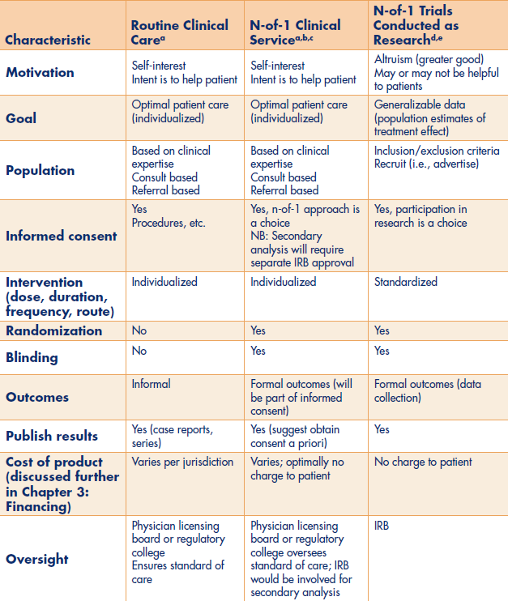
N-of-1 trial service compared with research and routine clinical care
Punja et al. 2014. Chapter 2, AHRQ report: Design and implementation of N-of-1 trials: A user’s guide.
Notes:
Punja S, Vohra S, Eslick I, Duan N. An ethical framework for N-of-1 trials: Clinical care, quality improvement, or human subjects research? In: Kravitz RL, Duan N, DEcIDE Methods Center N-of-1 Guidance Panel, eds. Design and implementation of N-of-1 trials: A User’s guide. Rockville, MD: Agency for Healthcare Research and Quality; 2014:13-22.

Slide 22
The Future of N-of-1
“N-of-1 trials are relevant when RCTs are not available/applicable” ……..
RCTs are relevant when N-of-1 trials are not available/applicable

Slide 23
Thank you
Questions? svohra@ualberta.ca

